Slide 1
Introduction to Convolutional Neural Networks Slides adapted from - Dr. Lakshmi Babu-Saheer

Slide 2
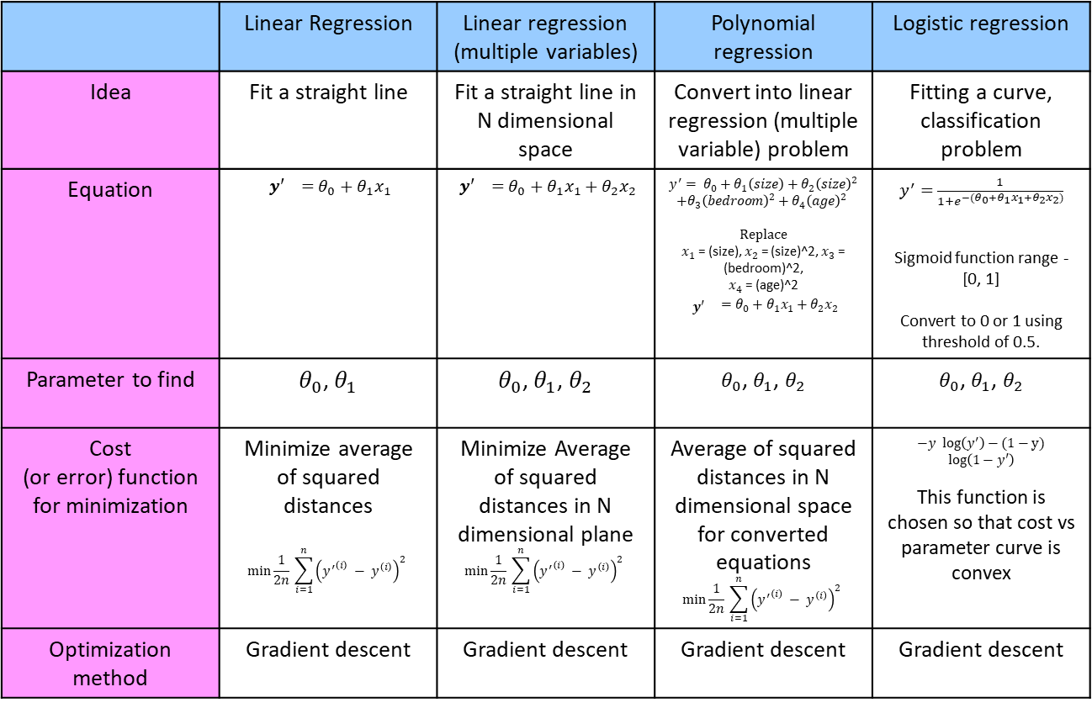
Summary
 | Linear Regression | Linear regression (multiple variables) | Polynomial regression | Logistic regression
Idea | Fit a straight line | Fit a straight line in N dimensional space | Convert into linear regression (multiple variable) problem | Fitting a curve, classification problem
Equation | $${ y′ }_{}=θ_{0}+θ_{1}x_{1}$$ | $${ y′ }_{}=θ_{0}+θ_{1}x_{1}+θ_{2}x_{2}$$ | $${y^{′}= θ}_{0}+θ_{1}\left(size\right)+θ_{2}{\left(size\right)}^{2}$$ $$+θ_{3}{\left(bedroom\right)}^{2}+θ_{4}{\left(age\right)}^{2}$$ Replace $x_{1}$ = (size), $x_{2}$ = (size)^2, $x_{3}$ = (bedroom)^2, $x_{4}$ = (age)^2 $${\begin{aligned} \\ y′ \end{aligned}}_{}=θ_{0}+θ_{1}x_{1}+θ_{2}x_{2}$$ | $y^{′}=$ $\frac{1}{1+e^{−{(θ}_{0}+θ_{1}x_{1}+θ_{2}x_{2})}}$ Sigmoid function range - [0, 1] Convert to 0 or 1 using threshold of 0.5.
Parameter to find | $θ_{0}$, $θ_{1}$ | $θ_{0}$, $θ_{1}$, $θ_{2}$ | $θ_{0}$, $θ_{1}$, $θ_{2}$ | $θ_{0}$, $θ_{1}$, $θ_{2}$
Cost (or error) function for minimization | Minimize average of squared distances $$\min_{}{\frac{1}{2n} \sum_{i=1}^{n}{{\left({y^{′}}^{\left(i\right)} − y^{\left(i\right)}\right)}^{2} }}$$ | Minimize Average of squared distances in N dimensional plane $$\min_{}{\frac{1}{2n} \sum_{i=1}^{n}{{\left({y^{′}}^{\left(i\right)} − y^{\left(i\right)}\right)}^{2} }}$$ | Average of squared distances in N dimensional space for converted equations $$\min_{}{\frac{1}{2n} \sum_{i=1}^{n}{{\left({y^{′}}^{\left(i\right)} − y^{\left(i\right)}\right)}^{2} }}$$ | $−y log\left(y^{′}\right)−(1−y)$ $log\left(1−y′\right)$ This function is chosen so that cost vs parameter curve is convex
Optimization method | Gradient descent | Gradient descent | Gradient descent | Gradient descent
Note: Gradient descent is one of the optimization algorithm. There exists other optimization method too.

Slide 3
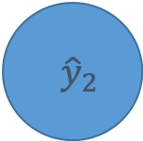
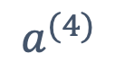
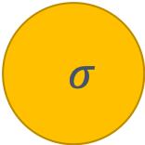
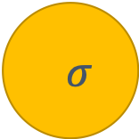
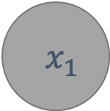
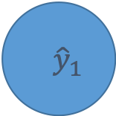
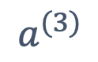


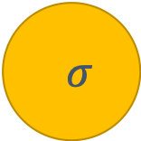

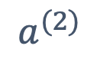

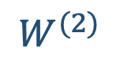
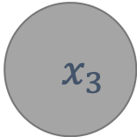
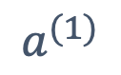

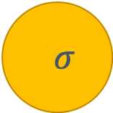

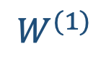

What did you Learn till now?
Basic Architecture and Components of a NN.
Training considerations including
Optimizers
What Next…?
New Architectures!
$$a^{(2)}$$
$$a^{(3)}$$
$$a^{(4)}$$
$$a^{(1)}$$
$$σ$$
$$σ$$
$$x_{1}$$
$${ \hat{y}}_{1}$$
Cost
(J)
$$σ$$
$$σ$$
$${ x}_{2}$$
$${ \hat{y}}_{2}$$
$$σ$$
$$σ$$
$${ x}_{3}$$
$${ \hat{y}}_{3}$$
$$σ$$
$$σ$$
$$W^{(1)}$$
$$W^{(2)}$$
$$W^{(3)}$$

Slide 4
Artificial Neural Network: Multi-Layer Perceptron

Slide 5
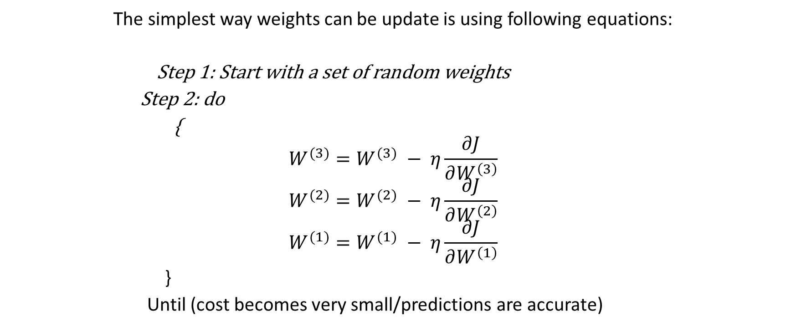
Updating weights
The simplest way weights can be update is using following equations:
Step 1: Start with a set of random weights
Step 2: do
{
$$W^{(3)}=W^{(3)} − η\frac{∂J}{∂W^{\left(3\right)}}$$
$$W^{(2)}=W^{(2)} − η\frac{∂J}{∂W^{\left(2\right)}}$$
$$W^{(1)}=W^{(1)} − η\frac{∂J}{∂W^{\left(1\right)}}$$
}
Until (cost becomes very small/predictions are accurate)
Gradient Descent

Slide 6
Convolution Neural Network

Slide 7
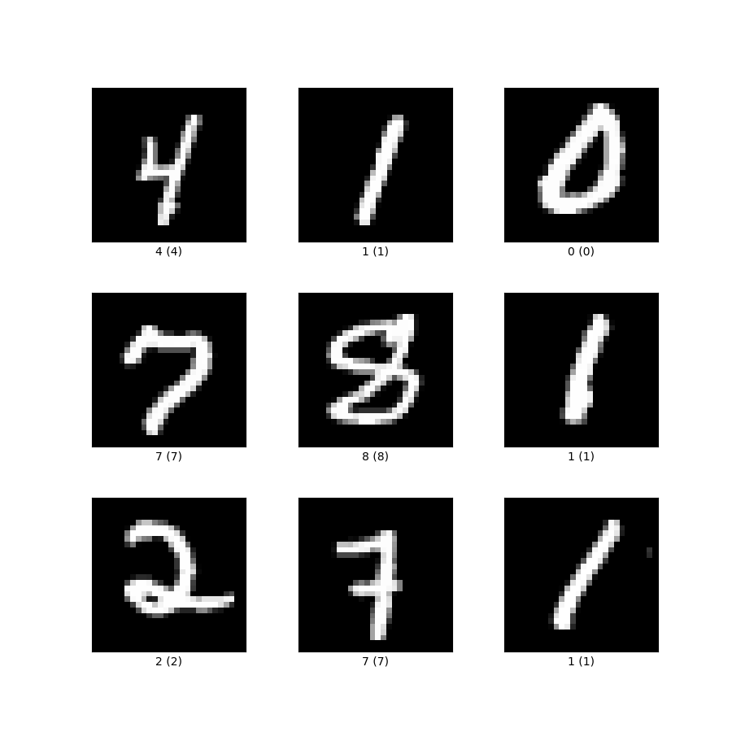
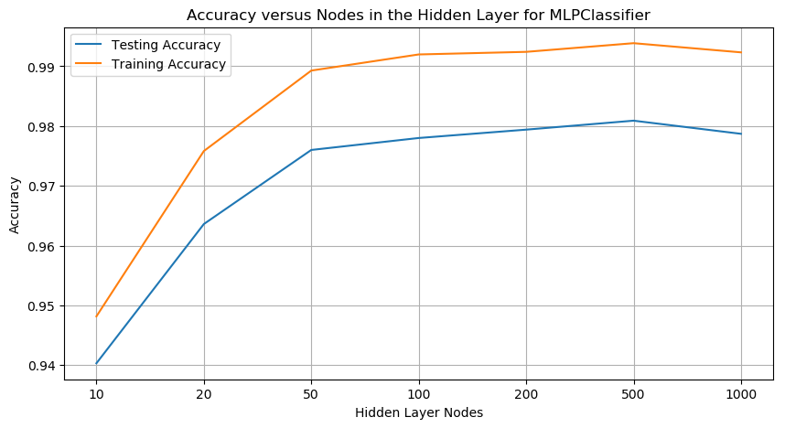
MLP for MNIST data
Very High accuracy using MLP

Slide 8
Any problem?
Clean images
Numbers are:
Centered
Approximately same size
Image only has number in it - background is black

Slide 9
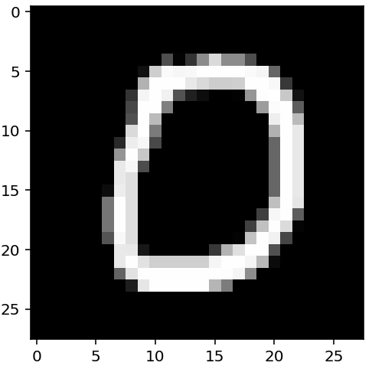
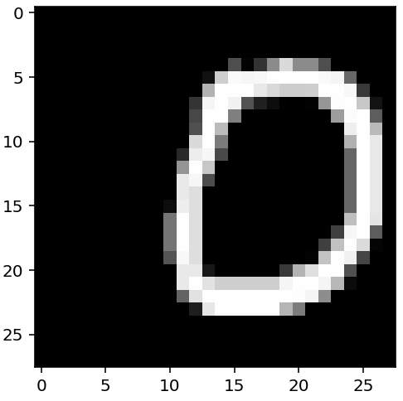
Problem 1: Translation invariance
If we translate the input, the model breaks down
We need to train (and test) models on translated data for more realistic scenario

Slide 10
Problem 2: Huge number of parameters
1200x1200 matrix of weights = 1.4 million weights
More weights → need more data
More weights → hard to scale on hardware
Memory constraints!
What can we do?

Slide 11
Convolutional Neural Networks
Convolution Layer - Pooling Layers - Convolution - Pooling …… dense at the end

Slide 12
Convolution Layers

Slide 13
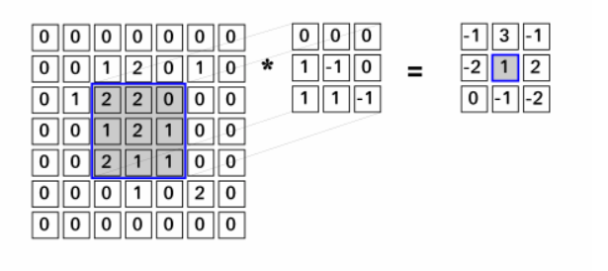
Convolution operation
Filter/Kernel
Output
Input

Slide 14
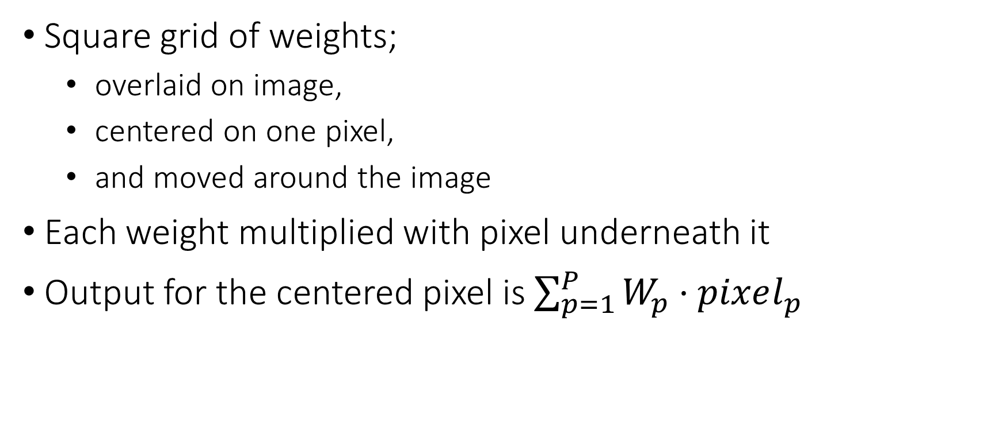
What are kernels?
Square grid of weights;
overlaid on image,
centered on one pixel,
and moved around the image
Each weight multiplied with pixel underneath it
Output for the centered pixel is $\sum_{p=1}^{P}{W_{p}⋅pixel_{p}}$
Notes:
Many notions of kernel in mathematics have to do with a center and a region around (and/or distances around and/or weighting by that distance). In this case, we apply a kernel as a template over a small region of an image
Example coming … don’t get hung up “hand waving” here.

Slide 15
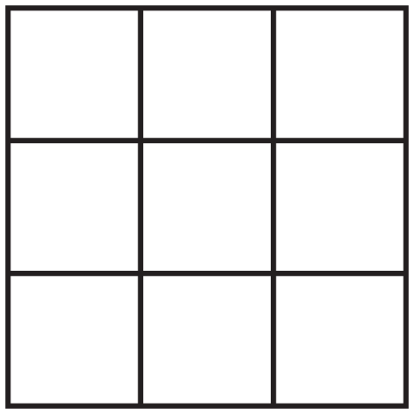
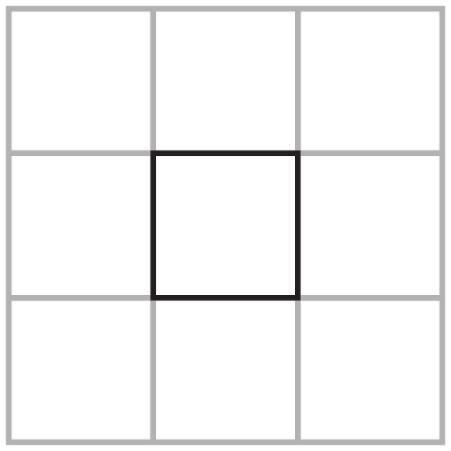
Example: 3x3
Input
Kernel
Output
3
2
1
-1
0
1
1
2
3
-2
0
2
1
1
1
-1
0
1

Slide 16

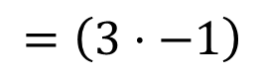
Example: 3x3
Input
Kernel
Output
3
2
1
-1
0
1
1
2
3
-2
0
2
1
1
1
-1
0
1
$$=\left(3⋅−1\right)$$

Slide 17
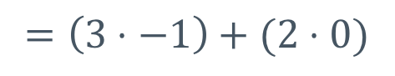
Example: 3x3
Input
Kernel
Output
3
2
1
-1
0
1
1
2
3
-2
0
2
1
1
1
-1
0
1
$$=\left(3⋅−1\right)+(2⋅0)$$

Slide 18
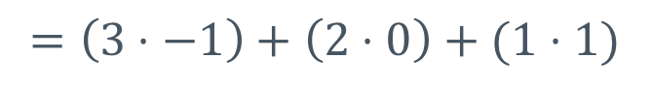
Example: 3x3
Input
Kernel
Output
3
2
1
-1
0
1
1
2
3
-2
0
2
1
1
1
-1
0
1
$$=\left(3⋅−1\right)+\left(2⋅0\right)+(1⋅1)$$

Slide 19
Example: 3x3
Input
Kernel
Output
3
2
1
-1
0
1
1
2
3
-2
0
2
1
1
1
-1
0
1
$$=\left(3⋅−1\right)+\left(2⋅0\right)+\left(1⋅1\right)+(1⋅−2)$$

Slide 20
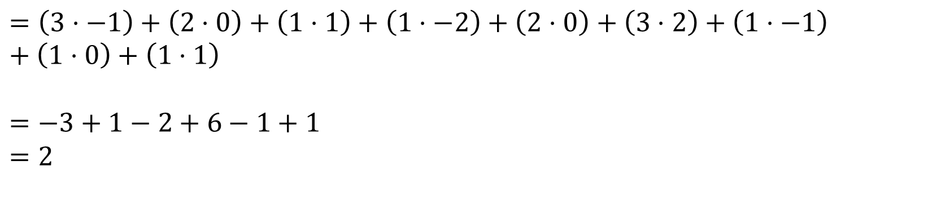
Example: 3x3
Input
Kernel
Output
3
2
1
-1
0
1
1
2
3
-2
0
2
2
1
1
1
-1
0
1
$$=\left(3⋅−1\right)+\left(2⋅0\right)+\left(1⋅1\right)+\left(1⋅−2\right)+\left(2⋅0\right)+\left(3⋅2\right)+\left(1⋅−1\right)+\left(1⋅0\right)+\left(1⋅1\right)$$
$$=−3+1−2+6−1+1$$
$$=2$$

Slide 21
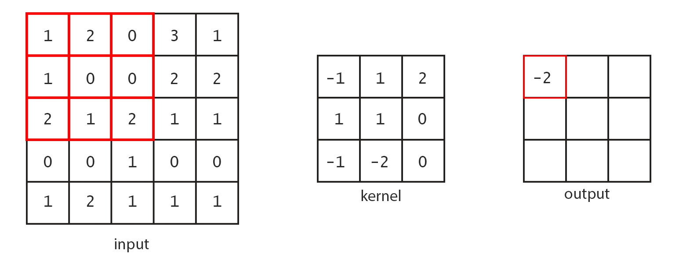
Here’s what the process looks like over a larger input:
Notes:
No build up slides here … there’s a nice animated gif in the notebook.

Slide 22
Convolutional Neural Networks
Idea: let neural network learn suitable kernels for task

Slide 23
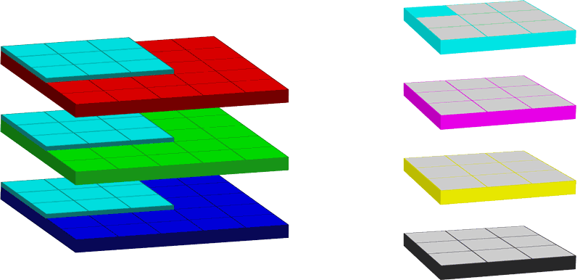
Convolution operation in N-Dimension!
Notes:
These are supposed to be either (1) a set of kernels for RGB (red green blue) or (2) a the same for CMYK (cyan magenta yellow black)
For our purposes, the convolution operation can be seen as a means for combining a kernel (which we will learn the weights of by training) with inputs (either pixels from an image or outputs from a prior network layer).

Slide 24

Convolution settings - Height and width
Number of pixels the kernel operates on
Both dimensions must be odd
we need a reasonable center pixel
Kernel doesn’t have to be square
Height: 3, Width: 3
Height: 1, Width: 3
Height: 3, Width: 1
Notes:
Odd dims b/c centering in even numbers is a problem and we don’t want to get into averaging/splitting between pixels.

Slide 25
Stride
Stride is the step size from center to center
Also has height/width component
Generally height/width are the same
If greater than 1, will scale down the
output dimensions
Notes:
Aka, if we stride bigger than 1,1 …. We will be “skipping over” some potential center pixels and thus we will be reducing on output. Examples to come!

Slide 26
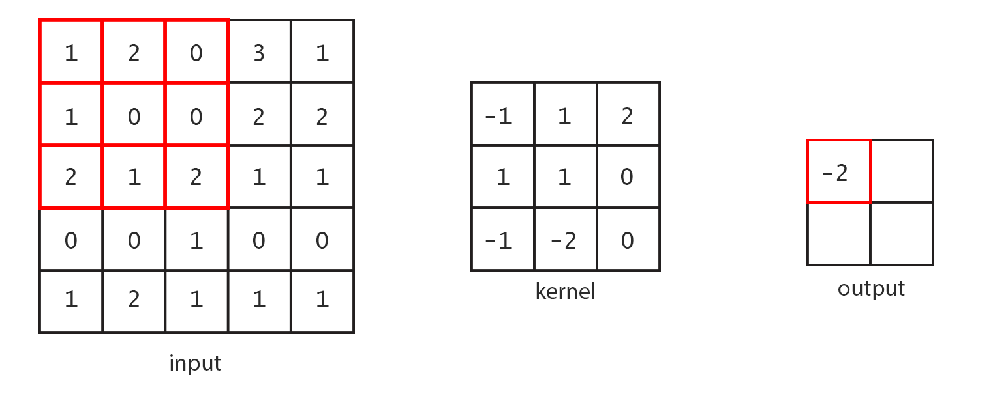
Stride 2 convolution – Find output?

Slide 27
Padding
Notice: the standard convolution down samples input
[5x5]
[3x3]
Notes:
That is, the standard convolution combines the input with the kernel and doesn’t have any way of filling in the input’s “fringe” (where the kernel can’t be centered due to its shape).

Slide 28
Padding
Padding adds pseudo-pixels off-the-edge of the input
Padding is all zero values
One unit of padding means one ring of zero pixels around the input.

Slide 29
How much padding?
Amount of padding is usually either:
No padding
Enough to offset the kernel size and output the same dimensions
TensorFlow calls this ‘SAME’ (i.e., same input/output size)
3x3 kernel → padding 1
5x5 kernel → padding 2
7x7 kernel → padding 3

Slide 30
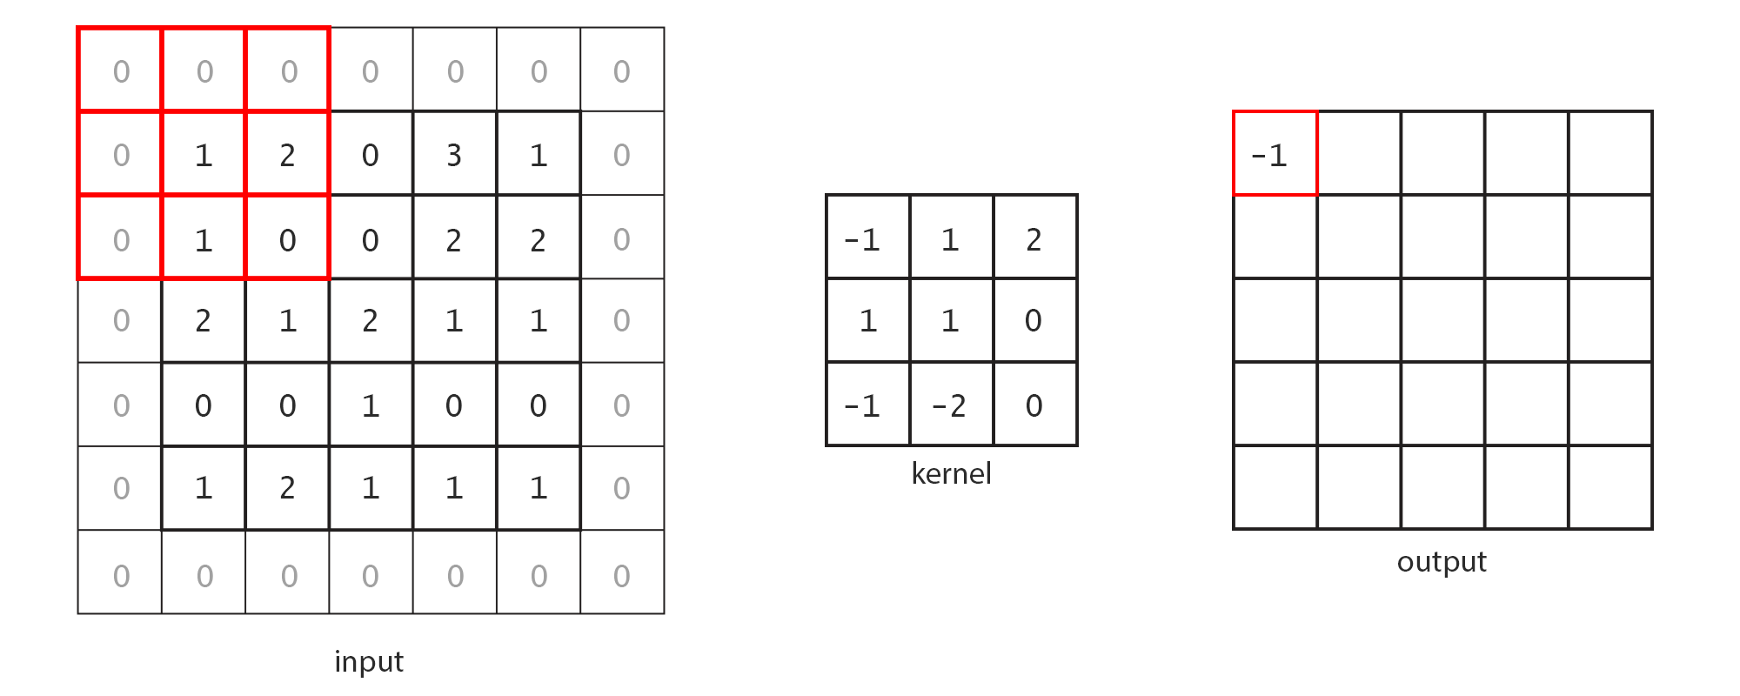
Padding: Activity
Size Same!
Notes:
Same means same output size as the input size. Means we have to add pseud—pixels around the input to fill things out.

Slide 31
Depth – Number of Output Channels
Channels: multiple numbers (colors) associated with same pixel
3-color RGB → 3 channels
4-color CMYK → 4 channels
Number of separate kernels needed in a layer
Notes:
Be careful: “deep networks” generally refers to the notion of many layers. Width of a layer is how many nodes it has. Read your academic papers closely.

Slide 32
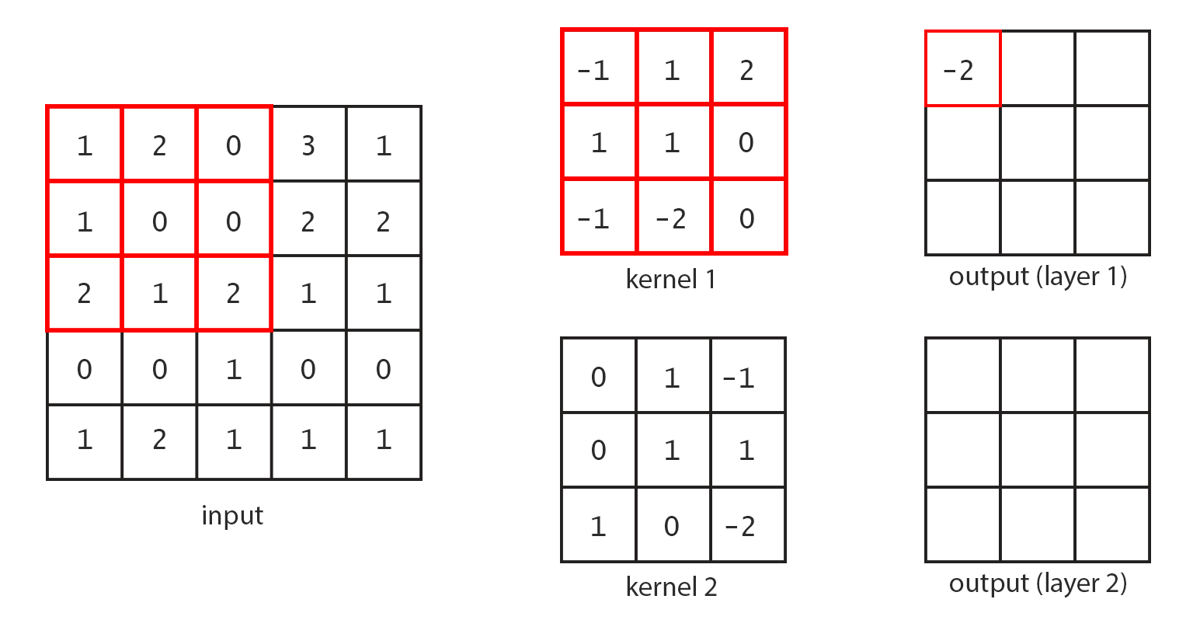
Output channels: 2 (Same layer output)
Notes:
If we want two output channels, we need two kernels. Note, we might have 0,1,2, or more inputs feeding several kernels.

Slide 33
Multi-dimensional Kernels
Depending on the input…
1D Convolution

Slide 34

Remember – applying activation function at the end
Remember
$$f()$$
Activation function

Slide 35
Pooling Layer

Slide 36
Pooling
Idea: reduce neighboring pixels
Reduce dimensions of inputs (height and width)
No parameters!

Slide 37
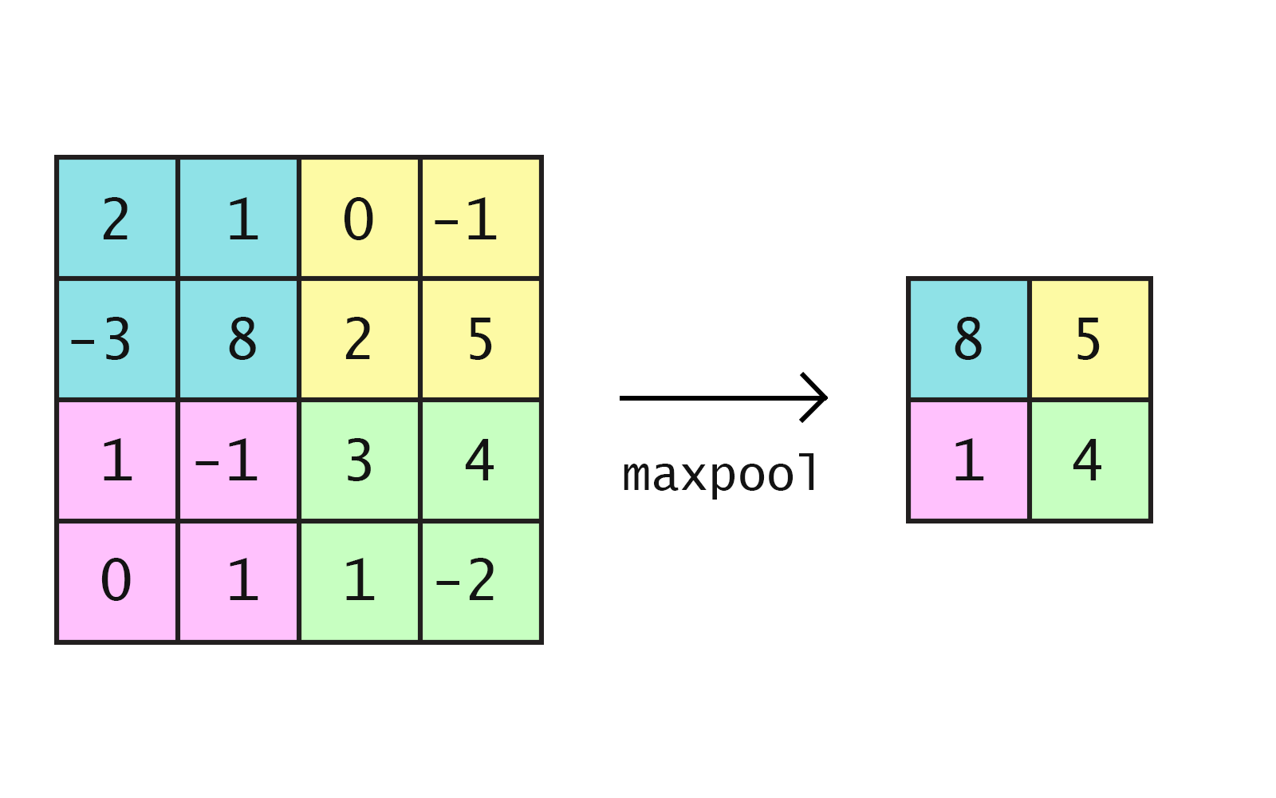
Max pooling

Slide 38
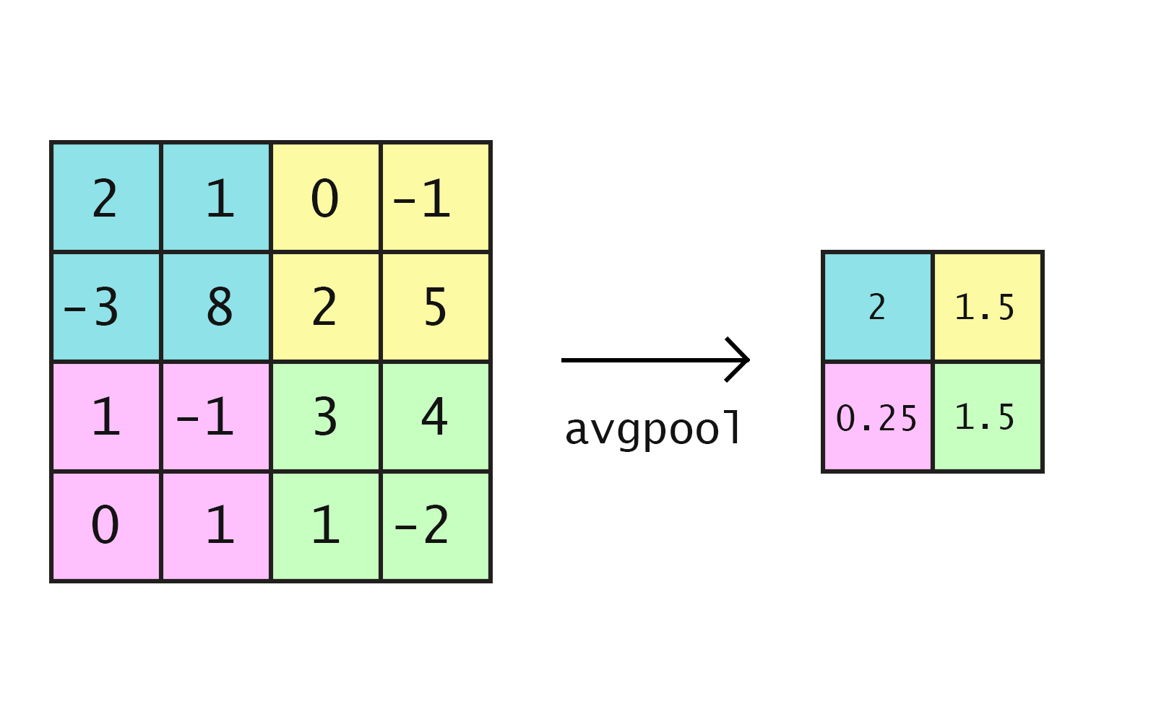
Average pooling

Slide 39
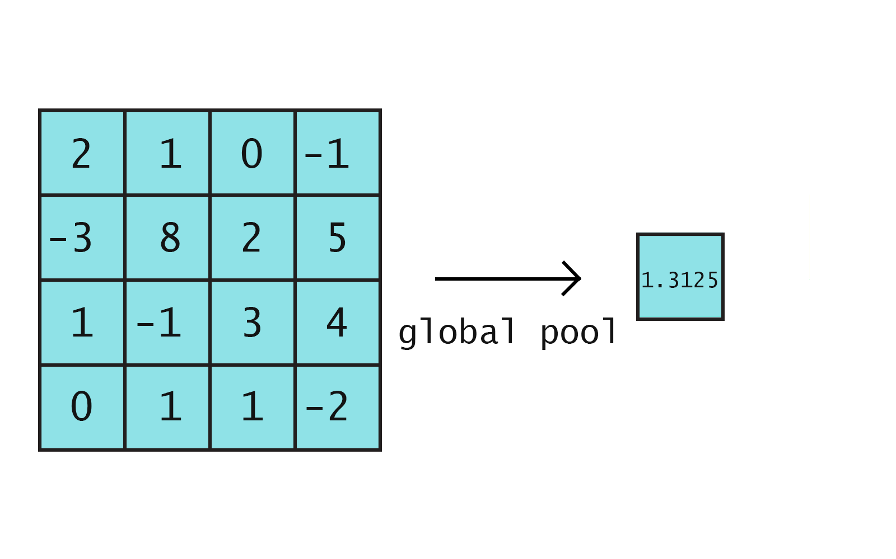
Global pooling
(Average pool over whole layer)

Slide 40
Convolution Neural Network

Slide 41
Convolutional Neural Networks
Convolution Layer + Pooling Layers + Convolution + Pooling …… dense at the end

Slide 42
LeNet – Based on Convolution
Created by Yann LeCun in the 1990s
Used on the MNIST dataset
Idea: Use convolutions to efficiently learn features on image data
Notes:
An image feature could be something like an edge detector or the orientation of the image. In classical image processing, a lot of hard work goes into manually processing images to extract features.

Slide 43
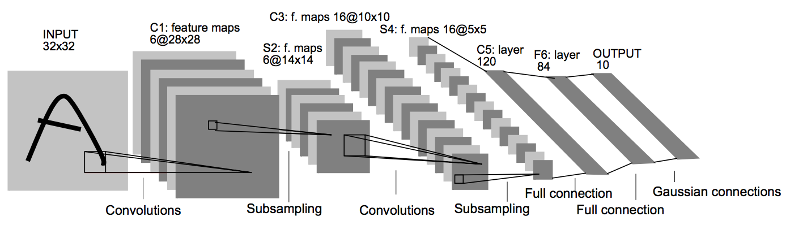
Network diagram
Notes:
We discuss some of this here, but we’ll make it concrete in the notebook.

Slide 44
Network diagram
Input: 28x28, with 2 pixels of padding (on all sides)

Slide 45
Network diagram
Convolution size: 5x5 (not labeled, but in paper)

Slide 46
Network diagram
First convolutional layer depth: 6

Slide 47
Network diagram
Pooling: 2x2, stride 2
Note: in the paper, the model uses a more complex parameter based pooling operation.
Max/average pooling turns out to work better in practice

Slide 48
Network diagram
Convolution size: 5x5

Slide 49
Network diagram
Second convolutional layer depth: 16

Slide 50
Network diagram
Pooling: 2x2, stride 2

Slide 51
Network diagram
Flatten from 5x5x16 to 400x1
Fully connected layer: from 400 to 120
Fully connected layer: from 84 to 10
Softmax

Slide 52
Table description of LeNet-5
Layer Name | Parameters
1. Convolution | 5x5, stride 1, padding 2 (‘SAME’)
2. Max Pool | 2x2, stride 2
3. Convolution | 5x5, stride 1, padding 2 (‘SAME’)
4. Max Pool | 2x2, stride 2
5. Fully connected (ReLU) | Depth: 120
6. Fully connected (ReLU) | Depth: 84
7. Output (fully connected ReLU) | Depth: 10

Slide 53
Summary
What is a CNN?
Components of a CNN
LeNet Architecture
CNN useful for images!

Slide 54
Interactive Kernel Demonstration
http://setosa.io/ev/image-kernels/
Notes:
These are more “applied” kernels, your mileage might vary.

Slide 55
Additional convolution operation resource
Andrej Karpathy’s convolutional network website
Created for Stanford’s CS231n course
http://cs231n.github.io/convolutional-networks/

